Slide 1
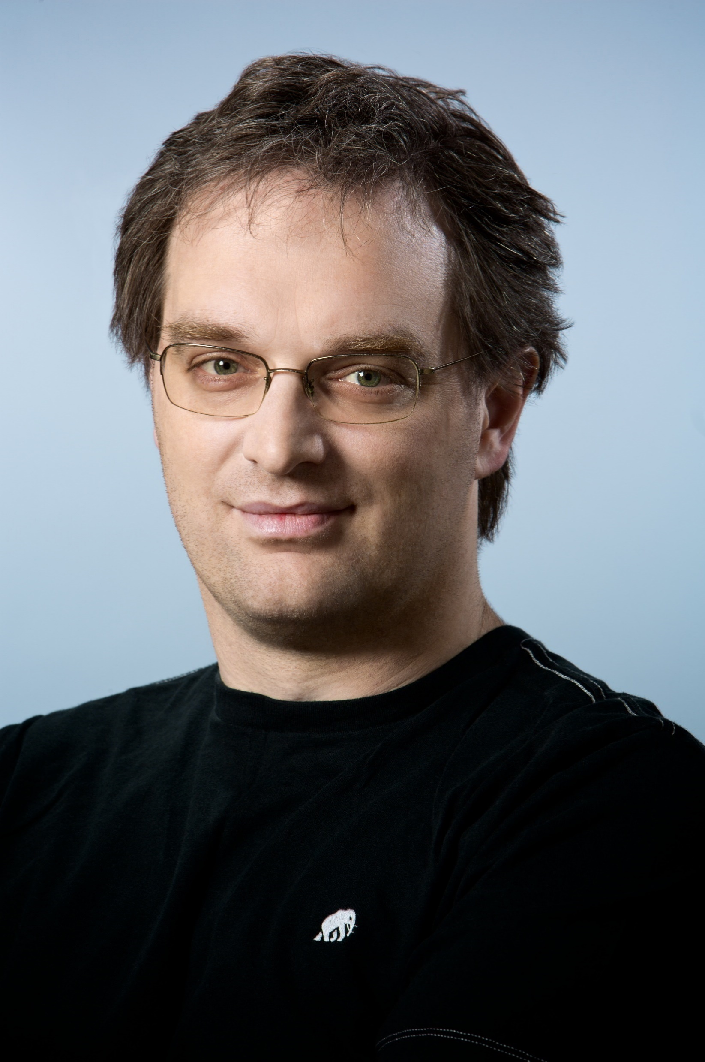
Causal Structure Discovery in Reinforcement learning
John Langford
@Microsoft Research

Slide 2
What is offline reinforcement learning?
Action
Action
Policy ?
Policy ?
Observation
Observation
Reward
Reward
So Offline means Off-policy.

Slide 3
How can off-policy learningevaluation be done?
Importance Weight based Counterfactual Evaluation
1952: Horvitz & Thompson. First version
1995: Auer, Cesa-Bianchi, Freund, Schapire: (Contextual) Bandits
2000: Precup, Sutton, Singh: Multi-step reinforcement learning
2011: Dudik, Langford, Li: Doubly robust approaches.
<many variance improvements>
2016: Jiang & Li: states help
2019: http://aka.ms/personalizer : Commercial system routinely using
2020: Karampatziakis, Langford, Mineiro: Tight confidence intervals
The big remaining issue: high variance $⇒$ data hungry.

Slide 4
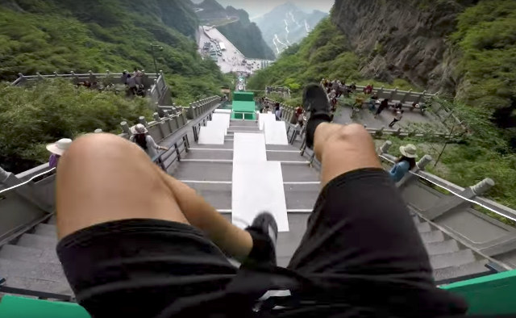
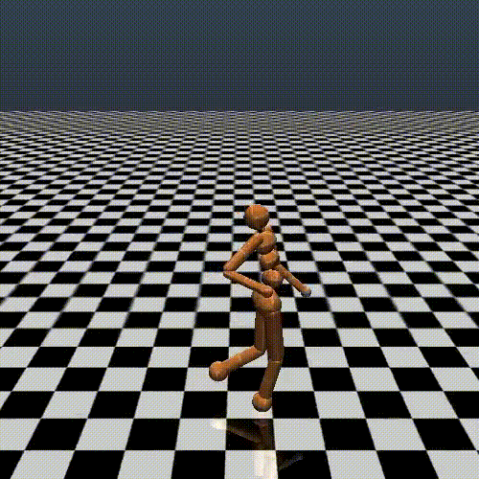
What is a state?
“Your current observation.” RL-layman
“Sufficient information to base an action on.” RL-Traditional
“Minimal sufficient information to base an action on.” Physics
Position
Orientation
Velocity
Of each object

Slide 5
How do we find minimal sufficient information to base an action on?
What is minimal?
… unclear
Position
Orientation
Velocity
Of each object

Slide 6
So…. how do we at least find a lesser quantity of sufficient information to base an action on?

Slide 7
Some things that do not work in general
Bottleneck autoencoder and declare the bottleneck a state.
[THFSCDSDA17]
Encoding “quality” is maximized by predicting pure noise bit.
Predict previous action through bottleneck from previous and current observation. [PAED17]
{$s_{1},s_{2}\},\text{\{}s_{3},s_{4}\}→a_{1}$
{$s_{1},s_{2}\},\text{\{}s_{5},s_{6}\}→a_{2}$
$$\text{\{}s_{3},s_{4}\},\text{\{}s_{7},s_{8}\}→a_{1}$$
$\text{\{}s_{5},s_{6}\},\text{\{}s_{7},s_{8}\}→a_{2}$
Yet there exists a policy which can always reach $s_{7}$.
“Bisimulation” [GDG03, LWL06]: Alias “states” with the same dynamics & rewards.
Statistically intractable to learn. [MJTS19, Appendix B]

Slide 8
The Block MDP Problem [DKJADL19]
Repeatedly
For $h = 1$ to $H$
See Observation $x$ // Trail view
Take Action $a$ // Left or right at the fork.
See Reward $r$ // Finding the mountain peak.
Block Markov Decision Process
States $S$, Actions $A$, Initial States $P(s)$, Transition Matrix $T(s’|s, a)$, reward $R(r|s, a)$, Horizon $H$, Observations $q(x|s)$ with $x$ disjoint over $s$.
Assumption: Realizable supervised policy oracle
For each cost sensitive classification learning problem $D(x,\vec{c})$ a policy class $Π$ contains the optimal solution, and an oracle returns in unit time: $arg \min_{π∈Π}\sum_{\left(x,\vec{c}\right)∈S}{c_{π\left(x\right)}}$
Notes:
Add concrete example here, Maybe give example of policy class

Slide 9
Homer [MHKL19]
For each horizon $h=1$ to $H$
Explore: Several times, for each latent state $s$ reachable with $h−1$ steps,
Use homing policy $π_{s}$ to find observation $x$ generated by latent state $s$
Use random action $a$
Make next observation $x′$
Abstract:
Learn to predict whether $x′$ swapped
$\left(p,φ \right)={argmin}_{p,φ} {\hat{E}}_{((x,a,x^{′}),y)} {\left(p\left(φ\left(x\right),a,φ\left(x′\right)\right)−y\right)}^{2}$
Home: For each value of bottleneck $s=φ(x′)$
Learn homing policy $π_{s}$ maximizing chance of $s$ given homing policies
Return Homing Policies
$$(\left(x,a,x^{′}\right),1)$$
$$(x,a,x^{′})$$
$$\left(\left(x,a,Uniform\left(x^{′}\right)\right),0\right)$$

Slide 10
Homer results
Theorem
$∀$Block MDPs where every state can be visited with high probability, If learning oracles for $Π,\left(p,φ\right)$ work with probability $1−δ$ can learn $ε$ optimal policy with Poly $(\left|A\right|,\left|S\right|,\log\left|F\right|,\log\left|Π\right|, log \frac{1}{δ},\frac{1}{ε}, H)$ samples.
Rich observations + deep learning $⇒$ Covering set of policies
Covering set of policies $⇒$ efficiently learn to optimize any reward function

Slide 11
Why does Homer work?
Backward Kinematic Inseparability
$x_{1}^{′}$ , $x_{2}^{′}$ are backwards KI if $∀u$ $\frac{T\left(x_{1}^{′} | x,a\right)u\left(x,a\right)}{\sum_{\tilde{x},\tilde{a}}{T\left(x_{1}^{′} | \tilde{x},\tilde{a}\right)u\left(\tilde{x},\tilde{a}\right)}}=\frac{T\left(x_{2}^{′} | x,a\right)u\left(x,a\right)}{\sum_{\tilde{x},\tilde{a}}{T\left(x_{2}^{′} | \tilde{x},\tilde{a}\right)u\left(\tilde{x},\tilde{a}\right)}}$
Lemma
If $x_{1}^{′}$ , $x_{2}^{′}$ Backwards Kinematic Inseparable then $∀π_{1},π_{2}$ $\frac{P_{π_{1}}(x_{1}^{′})}{P_{π_{2}}(x_{1}^{′}) }=\frac{P_{π_{1}}(x_{2}^{′})}{P_{π_{2}}(x_{2}^{′}) }$

Slide 12
What’s common in latent state decoding?
Repeatedly:
Explore: easily explored things.
Abstract: latent state space.
Cover: set of hard-to-reach things.

Slide 13
2. Learning latent low rank MDP?[AKKS20]
FLAMBE
For each horizon h=1 to H
Explore: Several times, for each covering policy $π$ execute for h-1 steps to observe $x$, then act randomly for $a$ and observe $x’$.
Abstract: maximize $\sum_{\left\{x,a,x^{′}\right\}}{log φ\left(x,a\right)μ(x^{′})}$
Cover: Maximize range of $φ\left(x,a\right)$ when finding new covering policies
$$T(x^{′}∣x, a)$$
$$φ(x,a)$$
$$μ(x^{′})$$
=
Theorem
$∀$latent low rank MDPs, if learning oracles work, exploration succeeds after Poly $(\left|A\right|,d,\log\left|Φ\right|,\log\left|Μ\right|, log \frac{1}{δ},\frac{1}{ε}, H)$ samples.

Slide 14
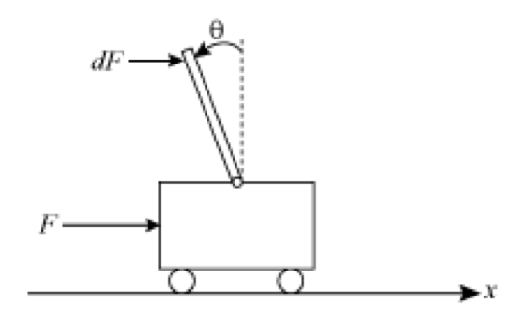
3. Learning linear dynamics? [MFSMSKRL20]
RichID-CE (start)
Explore:
Many times, act $k$ times $a\sim N(0,I)$ and to observe $x$
Abstract: find
$\hat{h}=arg \min_{h} \sum_{a}{{\left(h\left(x\right)−a\right)}^{2}}$
$\hat{f}\left(x\right)=\hat{E}\hat{h}\left(\vec{a}\right)\hat{h}{\left(\vec{a}\right)}^{⊤}\hat{h}(x)$
SystemID: $\hat{A},\hat{B}$…
Improve optimal policy decoder
$$s’=As+Ba+ε$$
$$q(x|s)$$
Theorem
$∀$ Rich observation linear dynamics MDPs, if learning oracles work, exploration succeeds after Poly $(d_{s},d_{a},\log\left|F\right|, log \frac{1}{δ},\frac{1}{ε}, H)$ samples.

Slide 15
Summary
Offline is for Off-policy
Off-Policy + many steps needs States
States need Minimal States
Minimal States requires Latent State discovery
Latent State Discovery works via State-defining prediction problems
TBD…

Slide 16
Importance Weighting
D. G. Horvitz & D. J. Thompson, A Generalization of Sampling Without Replacement from a Finite Universe, Journal of the American Statistical AssociationVolume 47, 1952 - Issue 260.
ACFS95 Peter Auer, Nicolò Cesa-Bianchi, Yoav Freund, Robert E. Schapire: Gambling in a Rigged Casino: The Adversarial Multi-Arm Bandit Problem. FOCS 1995: 322-331
Double Robust: Miroslav Dudík, John Langford, Lihong Li: Doubly Robust Policy Evaluation and Learning. ICML 2011: 1097-1104.

Slide 17
Bibliography, things that don’t work
GDG03 Givan, Dean, and Greig. Equivalence notions and model minimization in markov decision processes. Artificial Intelligence, 2003.
LWL06 Li, Walsh, Littman. Towards a unified theory of state abstraction for MDPs. ISAIM 2006.
PAED17 Pathak, Agrawal, Efros, Darrell. Curiosity-driven exploration byself-supervised prediction. ICML 2017
THFSCDSDA17 Tang, Houthooft, Foote, Stooke, Chen, Duan, Schulman, DeTurck, Abbeel. #Exploration: A study of count-based exploration for deep reinforcement learning. NeurIPS 2017.

Slide 18
Bibliography, Latent States
MHKL20 Misra, Henaff, Krishnamurthy, Langford. Kinematic State Abstraction and Provably Efficient Rich-Observation Reinforcement Learning, ICML 2020.
AKKS20 Agarwal, Kakade, Krishnamurthy, Sun. FLAMBE: Structural Complexity and Representation Learning of Low Rank MDPs NeurIPS 2020.
MFSMSKRL20 Mhammedi, Foster, Simchowitz, Misra, Sun, Krishnamurthy, Rakhlin, Langford, Learning the Linear Quadratic Regulator from Nonlinear Observations, NeurIPS 2020.

